Slide 1
Real-time Pose Estimation
Vision Based 3D Measurements
10616961 Fan Zhang
10569695 Chenzhuo Li

Slide 2
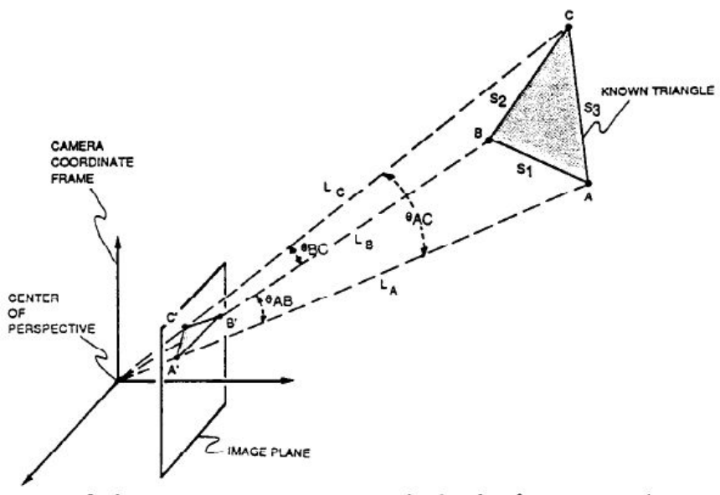
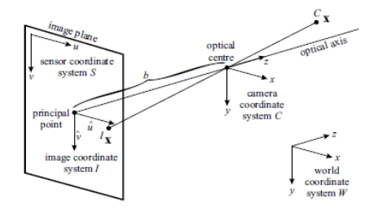
3D Pose Estimation Problem
3D pose estimation is the problem of determining the transformation(6 DOF: position and orientation) of an object in a 2D image which gives the 3D object.
The goal is to estimate the position and orientation of an object of known geometry in motion with respect to a fixed reference system.

Slide 3
3D Pose Estimation Problem
Camera calibration parameters
A rigid body of known geometry
A digital image of the rigid body
Pose Estimation
The camera body relative position (translation vector)
The camera body relative orientation (rotation matrix)

Slide 4
Pose Estimation Solution Overview
Camera Calibration
Image Acquisition Toolbox
Computer Vision Toolbox
Image Acquisition
Image Processing
Marker Extraction
Image Processing Toolbox
Robotics System Toolbox
Pose Estimation
Position & Orientation

Slide 5
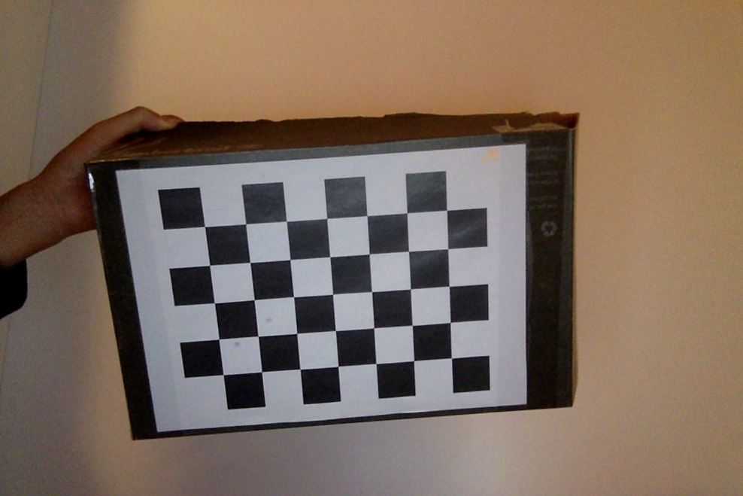
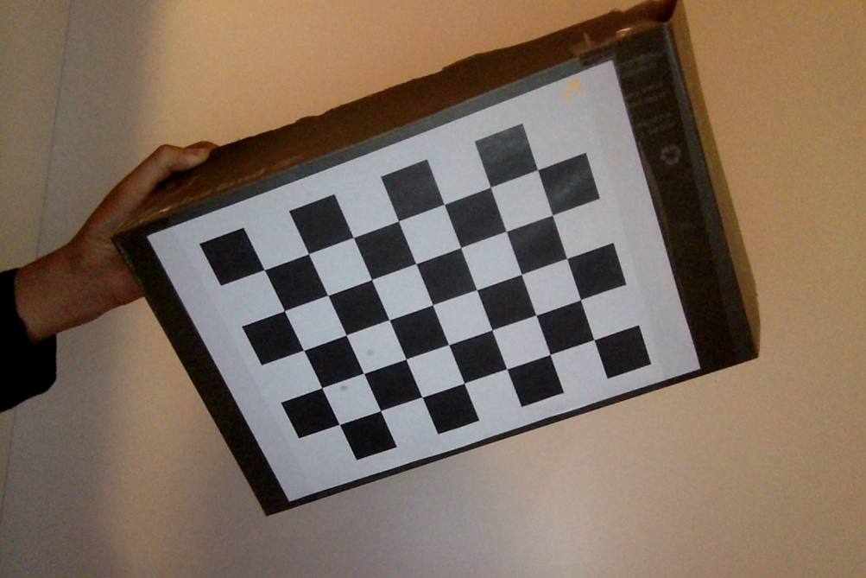
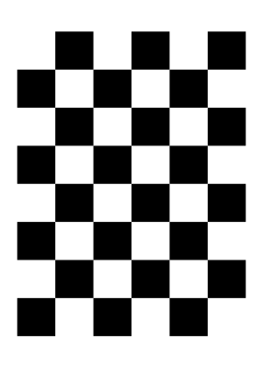
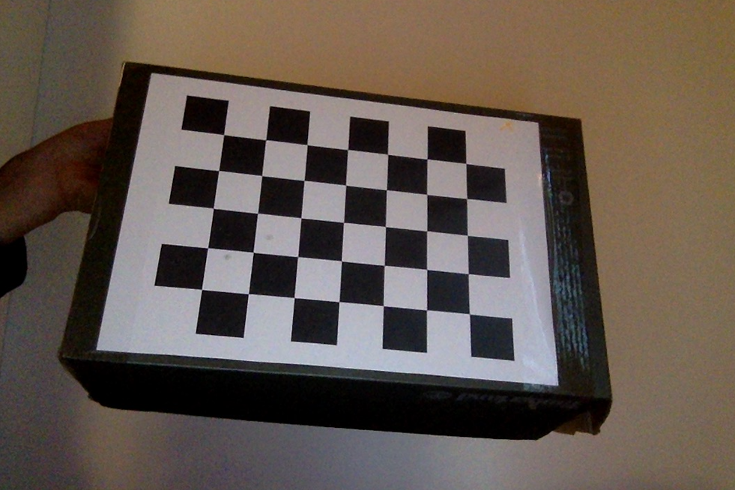
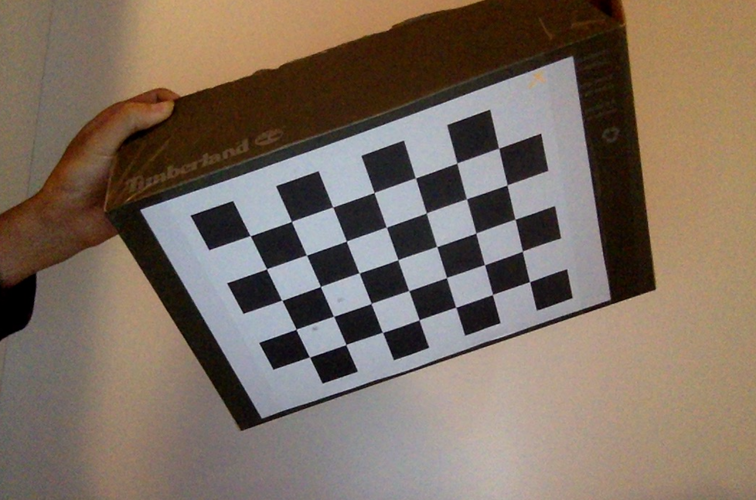
Pose Estimation Solution Camera Calibration
Using MATLAB camera calibrator application to get the intrinsic matrix of web camera and save it.
Chessboard
30mm × 30mm square
What we need is:
cameraParams.IntrinsicMatrix

Slide 6
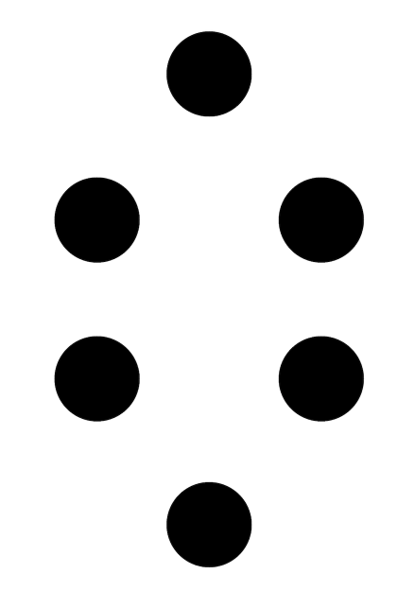
Pose Estimation Solution Object with known geometry
Generate marker with OpenCV
Size: 297mm × 210mm (A4)
Circle radius: 20mm

Slide 7
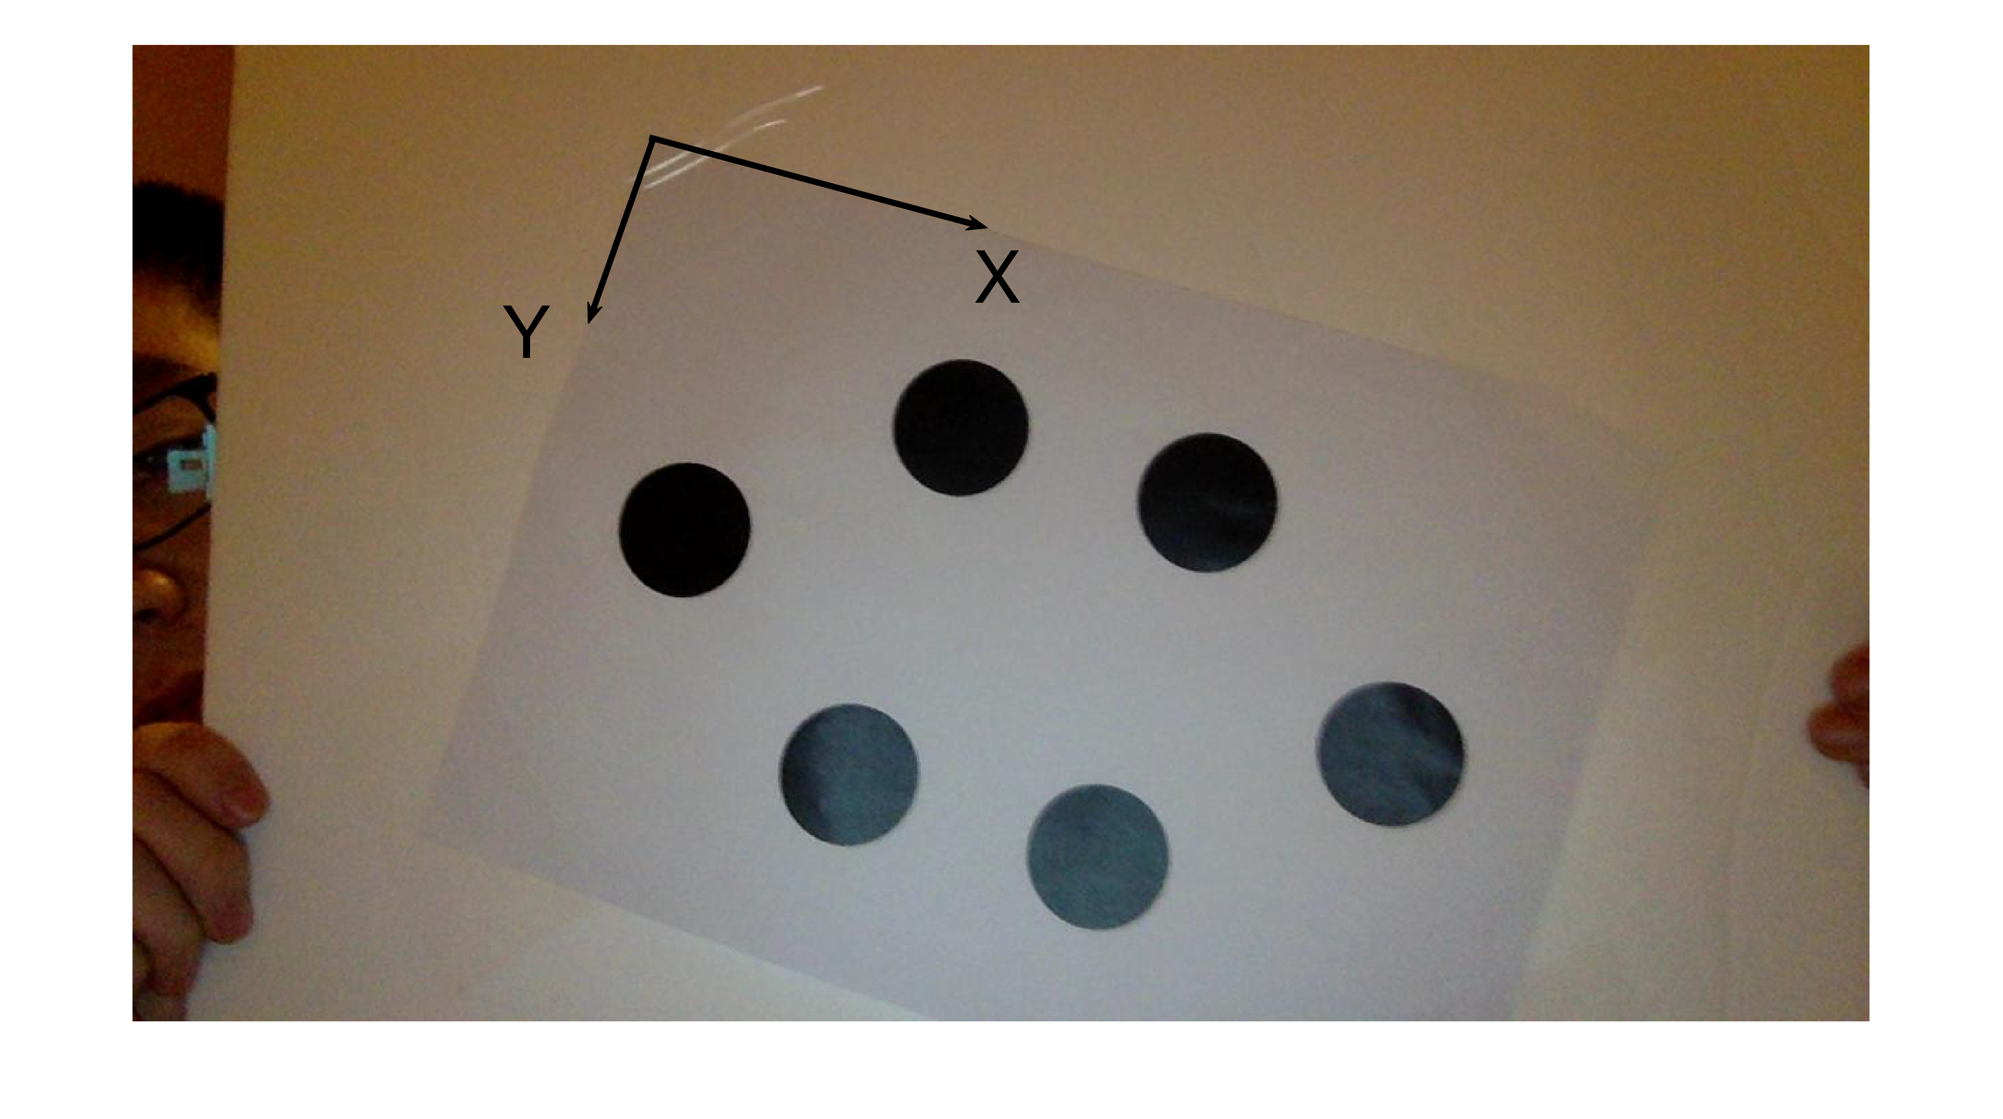
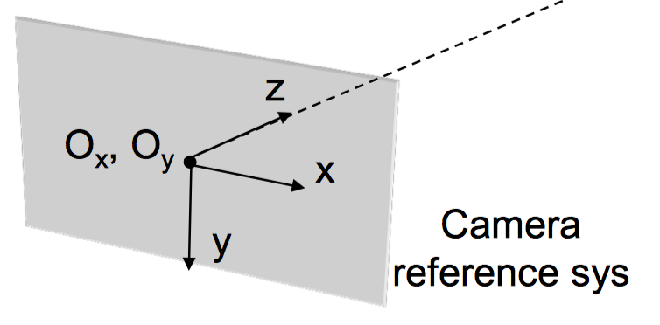
Pose Estimation Solution Object with known geometry
R,T
Marker(World) reference Sys

Slide 8
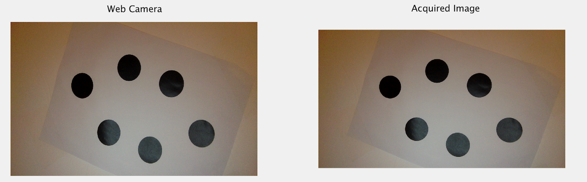
Pose Estimation Solution Image Acquisition
Using web camera to acquire images
vid = videoinput('macvideo', 1, YCbCr422_1280x720')
imgOriginal = getsnapshot(vid)
N.B. The acquisition procedure may change due to different platform.

Slide 9
Pose Estimation Solution Image pre-processing --- background remove
Functions
I = rgb2gray(RGB)
converts the truecolor image RGB to the grayscale intensity image I.
IM2 = imerode(IM,SE)
erodes the grayscale image IM, returning the eroded image, IM2. SE is a structuring element object returned by the STREL function.
IM2 = imdilate(IM,SE)
dilates the grayscale image IM, returning the dilated image, IM2. SE is a structuring element object returned by the STREL function.
Z = imsubtract(X,Y)
subtracts each element in array Y from the corresponding element in array X and returns the difference in the corresponding element of the output array Z.
J = imadjust(I)
increases the contrast of the output image J.

Slide 10
Pose Estimation Solution Image pre-processing --- binary image creation
Functions
LEVEL = graythresh(I)
computes a global threshold (LEVEL) that can be used to convert an intensity image to a binary image.
BW = imbinarize(I)
binarizes image I with a global threshold.
IM2 = imclose(IM,SE)
performs morphological closing on the grayscale or binary image IM with the structuring element SE.

Slide 11
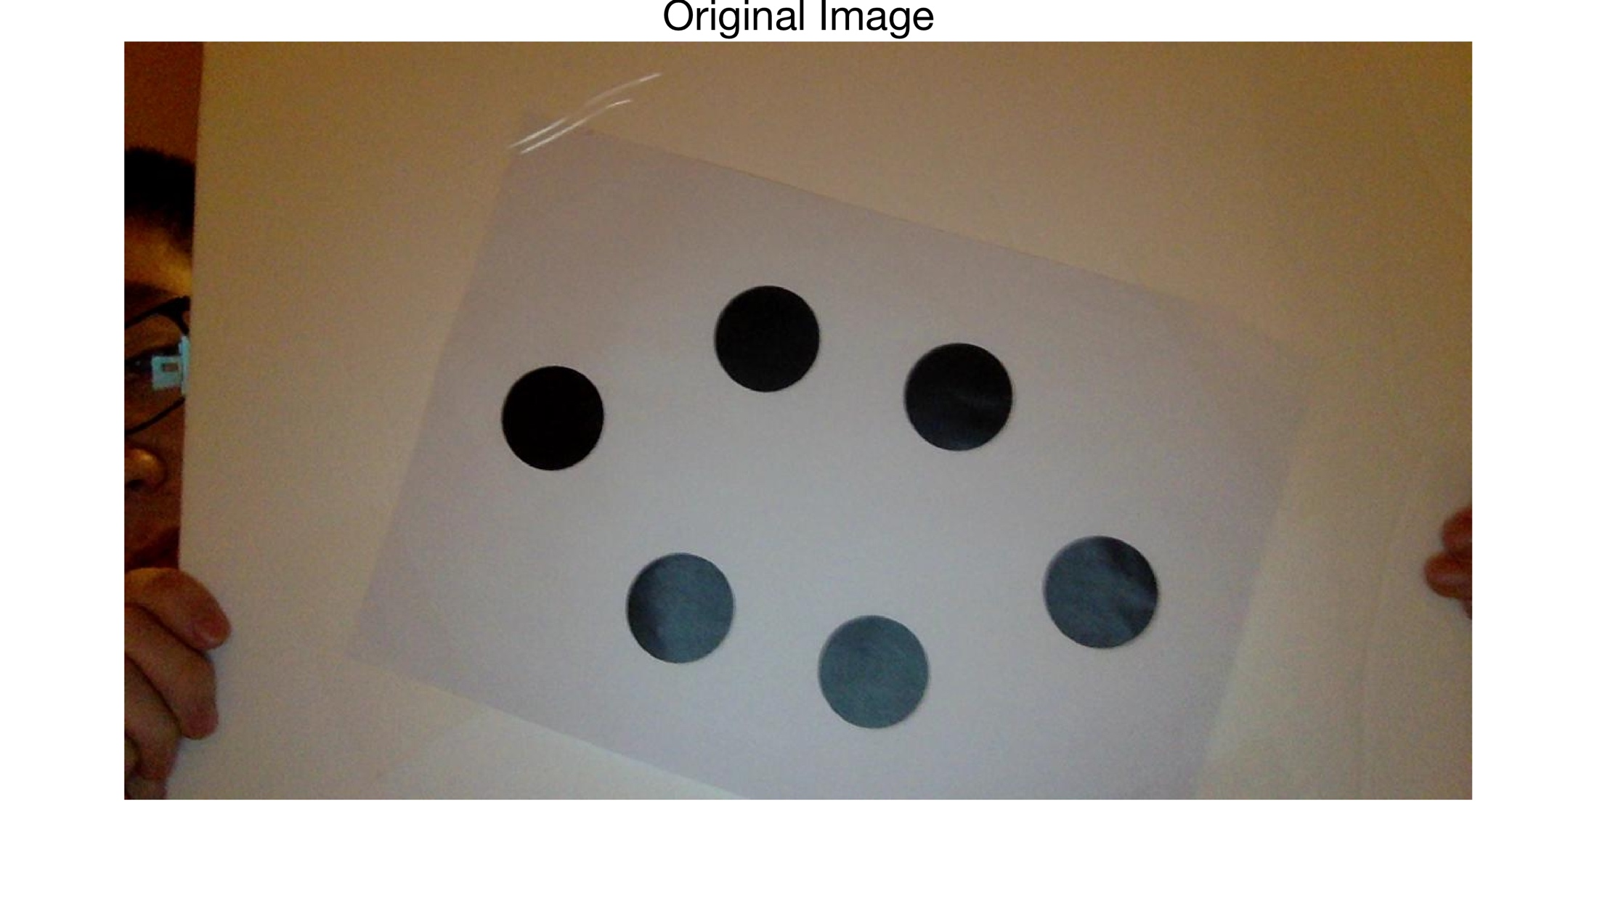
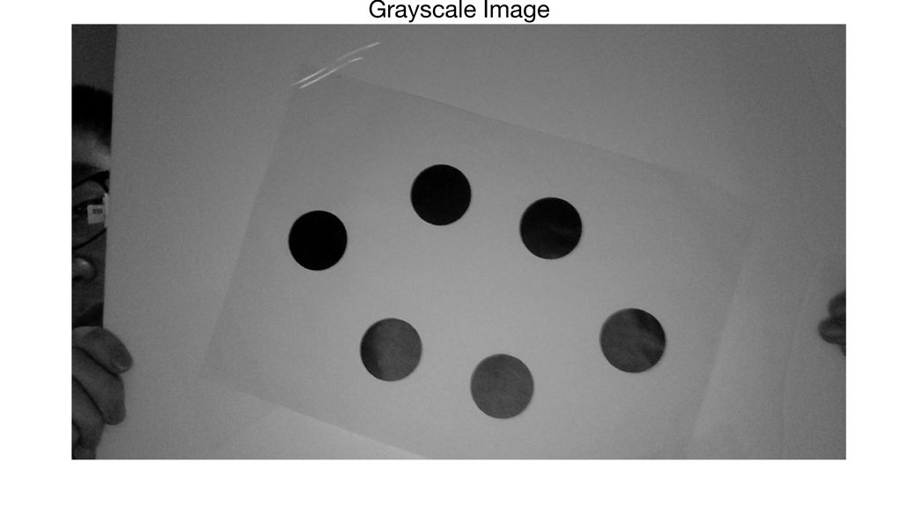
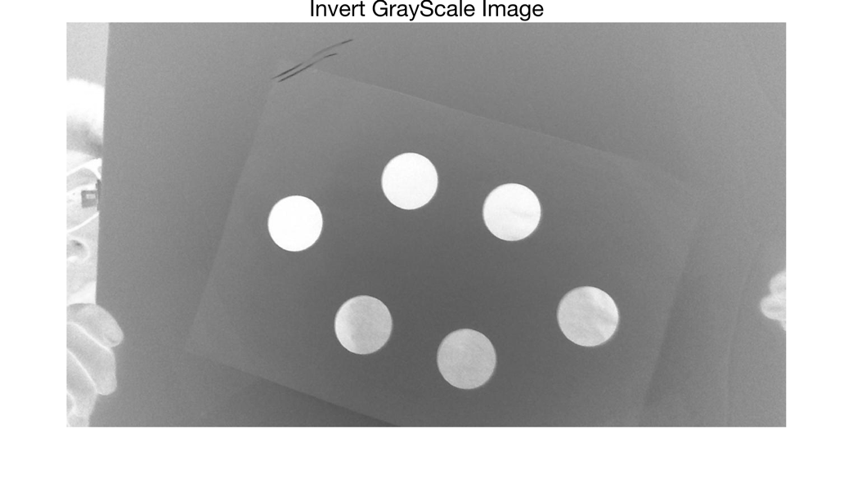
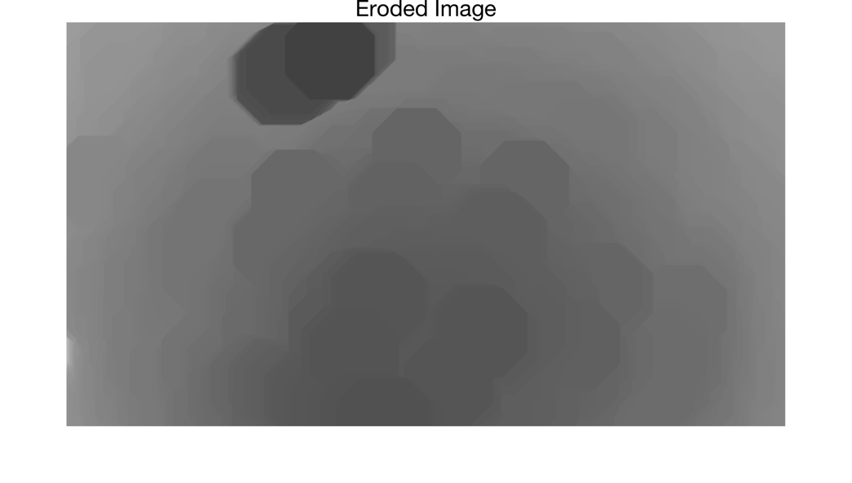
Pose Estimation Solution Image pre-processing
Image Background …

Slide 12
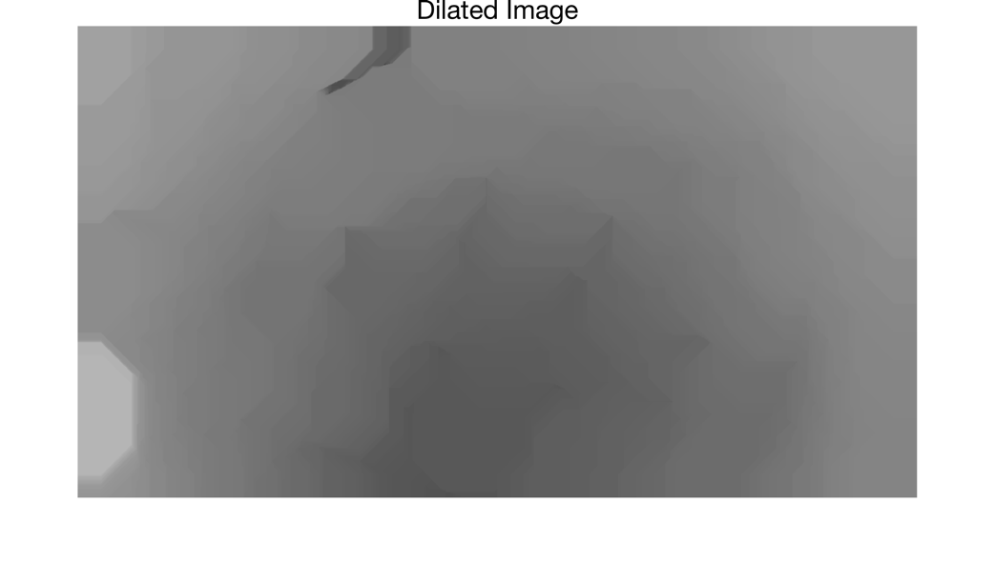
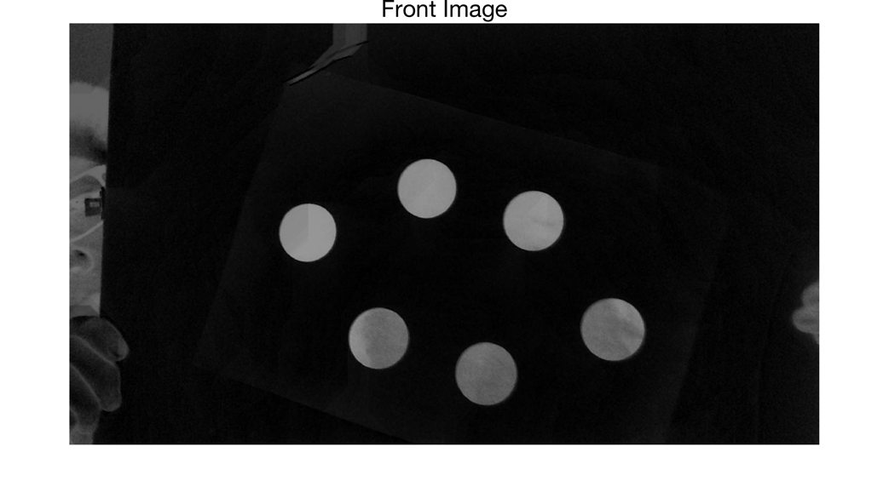
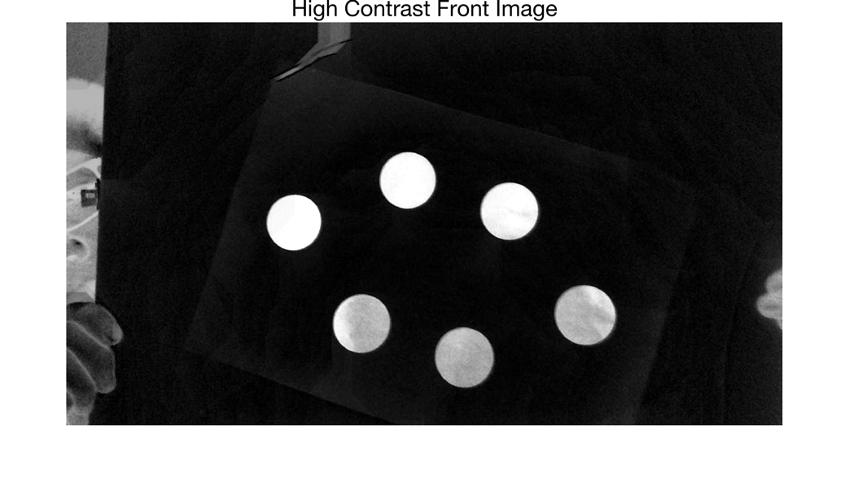
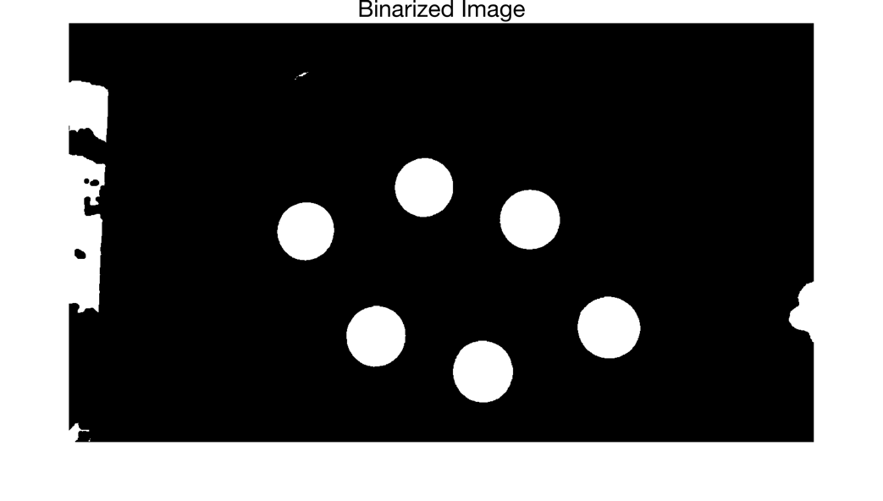
Pose Estimation Solution Image pre-processing
Image Background
Subtract

Slide 13
Pose Estimation Solution Image pre-processing --- extracting markers
Functions
L = bwlabel(BW,N)
returns a matrix L containing labels for the connected components in BW. N = 4 or 8, where 4 specifies 4-connected objects and 8 specifies 8-connected objects.
STATS = regionprops(BW,PROPERTIES)
measures a set of properties for each connected component (object) in the binary image BW. PROPERTIES can be a comma-separated list.
Since the eccentricity, area, and centroid of each component are known, we use eccentricity and area as thresholds to distinguish the markers from noise (in practice the values are set to 0.8 and 3000 to achieve high accuracy), and set the centroids as marker points.

Slide 14
Pose Estimation Solution Pose estimation
Functions
[worldOrientation, worldLocation] = estimateWorldCameraPose(imagePoints, worldPoints, cameraParams)
returns the orientation and location of a calibrated camera in the world coordinate system in which worldPoints are defined.
N.B. We change the value of MaxReprojectionError here to balance the accuracy and the fault-tolerance.
Mathematical calculation
Object orientation matrix is the transpose of the camera orientation matrix. R_{Obj} = (R_{Cam})^{T}
Object translation matrix is the minus product of camera location and object orientation matrix. T_{Obj} = - T_{Cam} × (R_{Cam})^{T}

Slide 15
Pose Estimation Solution Perspective-n-Point
Perspective-n-Point is the problem of estimating the pose of a calibrated camera given a set of n 3D points in the world and their corresponding 2D projections in the image. The camera pose consists of 6 degrees-of-freedom (DOF) which are made up of the rotation (roll, pitch, and yaw) and 3D translation of the camera with respect to the world.
When n = 3, the PnP problem is in its minimal form of P3P and can be solved with three point correspondences. However, with just three point correspondences, P3P yields many solutions, so a fourth correspondence is used in practice to remove ambiguity.
Gao, Xiao Shan, et al. "Complete solution classification for the perspective-three-point problem." IEEE Transactions on Pattern Analysis & Machine Intelligence 25.8(2003):930-943.

Slide 16
Pose Estimation Solution Important parameters
in marker extraction
Eccentricity
circle: e = 0
ellipse: 0 < e <1
In practice, this value is set to 0.8
Area
In practice, the areas of marker regions are larger than 3000. The value of this parameter may change with different camera in order to achieve the high accuracy.
in pose estimation
MaxReprojectionError
This parameter needs to be appropriate. If it is too small, not enough inliers in imagePoints and worldPoints can be found. If the value is too large, the result may not reliable.

Slide 17
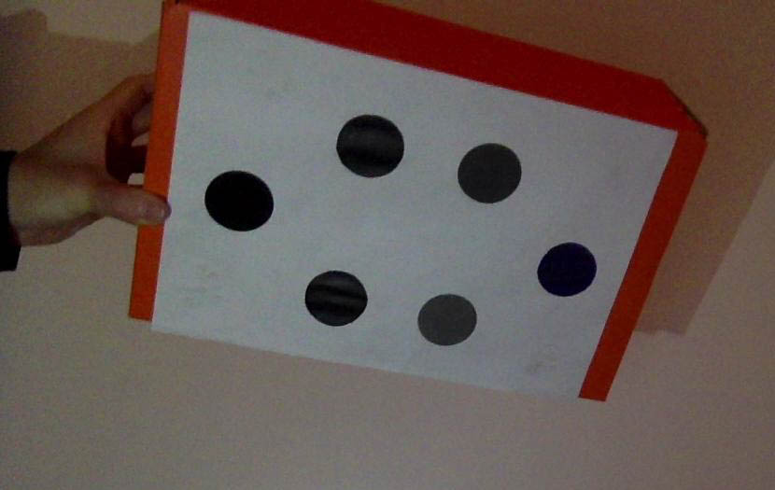
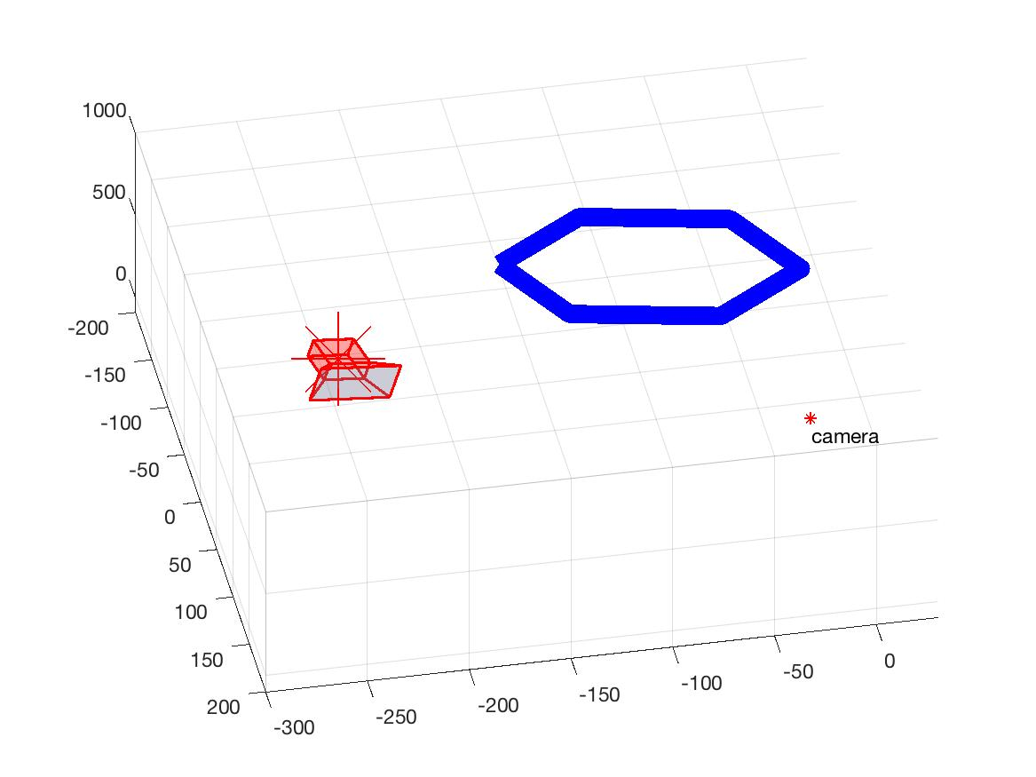
Pose Estimation Solution Pose post-processing
Function
EUL = rotm2eul(R)
converts a 3D rotation matrix, R, into the corresponding Euler angles, EUL.
TreDimReconstruct(objectMarkerCoordinatesinCRS, originofWRSinCRS, savePath, objectOrientationinCRS)
reconstruct object, camera in 3D, demonstrating the position and orientation.

Slide 18
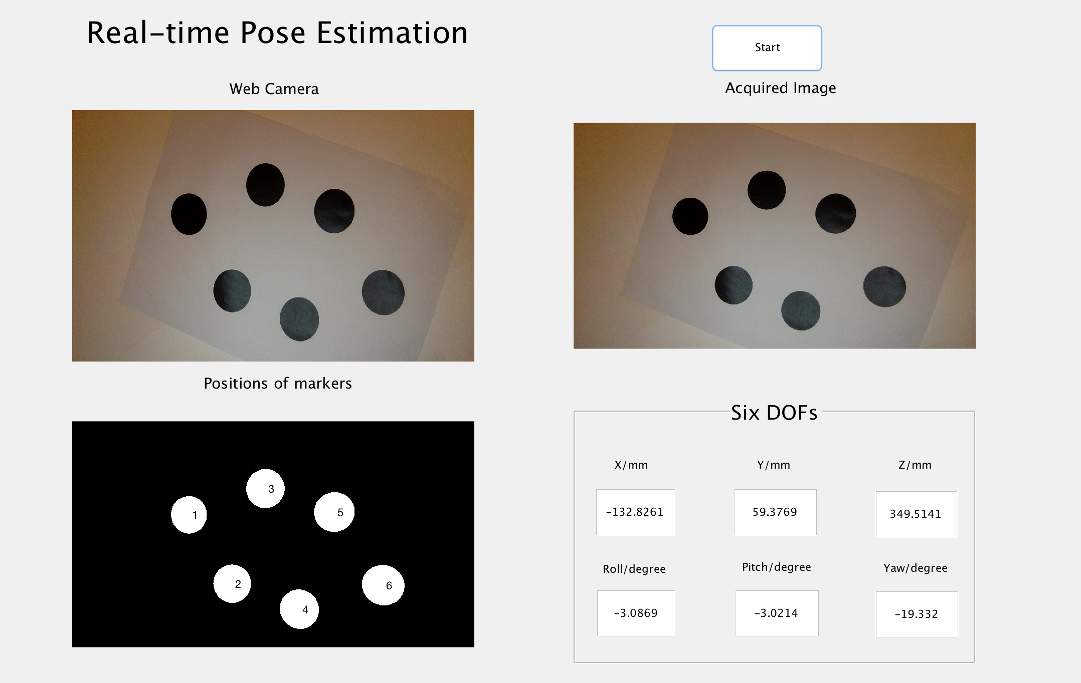
GUI: Visualize the result
In order to make the result more clear and specific, we create a GUI in MATLAB

Slide 19
Real-time Pose Estimation Project
Grazie !

